Slide 1
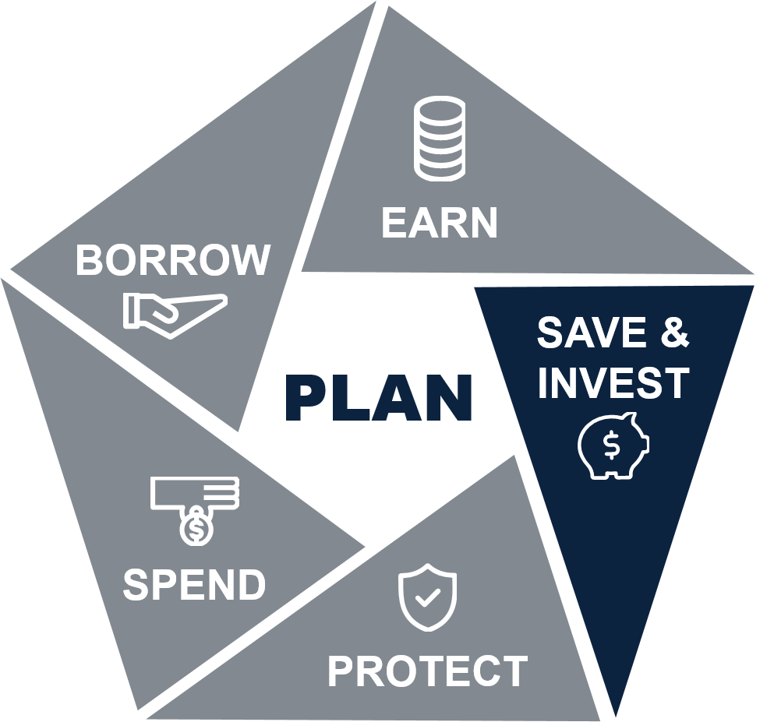
Starting a Family
Basic
Personal Financial Management Curriculum
Version 1.1
Notes:
Lesson Introduction: 2 minutes.
Introduce the lesson.
Welcome to Starting a Family.
The decision to start a family will lead to significant changes in your family budget.
As with any other decision that impacts your financial situation, it is wise to arm yourself with knowledge and a solid plan. The financial changes that accompany adding a new member to your family can be stressful. However, with a little education and up-front planning, you can greatly reduce the stress and avoid potential financial hardships.
This lesson provides information and activities to help you understand how adding a new family member can impact your budget.

Slide 2

Lesson Objectives
Determine how starting a family will affect your spending plan
Take the appropriate steps to ensure financial preparation when starting a family
Identify resources that are available when starting a family
Notes:
Provide the learning objectives.
After completing this lesson, you should be able to:
Determine how starting a family will affect your spending plan
Take the appropriate steps to ensure financial preparation when starting a family
Identify resources that are available when starting a family
Transition to the next topic.
Children will affect your budget in many ways. From diapers to day care to college, you will have many new expenses to consider.
Let’s begin with a few questions:
How many of you have played the Money Habitudes card sort game?
How many have taken the Money Habitudes: Discover Your Money Personality course?
Now my most important question is this: Can anyone tell me why I asked these questions?
Instructor note: Encourage discussion around understanding one’s own Money Personality and more importantly, understanding the spouse’s or significant other’s money personality.
Now that we have a viewpoint on the behavior aspects of money, let’s begin by examining these new expenses.

Slide 3

Cost of Raising a Child
Notes:
New Expenses: 20 minutes.
Cost of raising a child.
This topic presents new expenses that you may incur when starting a family.
The USDA report, “Expenditures on Children by Families also known as “The Cost of Raising a Child.” tracks the cost of raising a child by age of child, household income, budgetary component, and region of the country.
It is estimated that a family will spend approximately $13,000 annually per child in a middle-income ($59,200-$107,400), two-child, and married-couple family. Middle-income, married-couple parents of a child may expect to spend $233,610 ($284,570 if projected inflation costs are factored in*) for food, shelter, and other necessities to raise a child through age 17.
This does not include the cost of a college education. The cost of raising a child now approached $250,000 a year.
Now, let’s complete a group activity.

Slide 4
Activity: Brainstorming New Expenses
1. Brainstorm new expenses when starting a family.
2. Take 5 minutes.
3. List items on chart paper.
Notes:
Activity: Brainstorming New Expenses (10 minutes)
Introduce the activity. (1 minute)
Explain that the purpose of this activity is to brainstorm as many new expenses you can think of when starting a family.
Divide participants into small groups for this activity.
Conduct the activity. (6 minutes)
Give each group a piece of chart paper and colored markers.
Tell each group to write down as many new expenses they can think of that families may incur when having a child.
Tell them they will have 5 minutes to create their lists of expenses.
Have the participants list their new expenses on the piece of chart paper.
Begin the activity and call time after 5 minutes.
Debrief the activity. (3 minutes)
Call on a group to present its list of new expenses when starting a family.
In the interest of time, go around the room and have the other groups just add new items that weren’t previously presented.
Ask:
Were you surprised by any of the new expenses? Why?

Slide 5

New Expenses
Prenatal care
Parental leave
Nursery items
Postnatal care
Child care
Educational costs
Life insurance
Emergency fund
Notes:
Present new expenses that members may incur when starting a family.
Instructor note: As you present this content, refer to the lists of expenses that the participants brainstormed and note similarities and differences.
It’s important to consider the following expenses when starting a new family:
Prenatal care: Although some prenatal care is covered by TRICARE, there are some costs that are not covered. For example:
Sometimes expectant mothers are given special diets, which can affect a family’s food budget.
Women who require bed rest during pregnancy may lose a portion of income from their jobs. Some states may have regulations governing pregnancy related job losses or extended absences.
Deductibles associated with prenatal care may impact a family’s budget. This will depend on the type of TRICARE plan you chose for your family. Prime, Standard, and Extra all have different deductibles and co-pays.
Parental leave: Parental leave generally includes maternity, paternity, and adoption leave. Starting a family often requires taking some time off from your job. Questions to consider include:
What is your employer’s parental leave plan?
Can your family afford to take time off?
Will your employer allow you to be gone from work for days or possibly weeks?
It is important to plan and budget for this potential loss of income. When you need to take planned or unplanned time off from work to care for a child, there are a few options available to you:
Family and Medical Leave Act (FMLA): under the federal FMLA, your employer is not required to pay you for the time you take away from the job. In some cases, you may be able to use short-term disability to ensure an income while you are on parental leave.
Your state’s FMLA
Short-term disability
Spouse’s employer’s maternity/paternity leave policy, vacation, and other paid time off alternatives.
Be sure to consult your installation’s personal Financial Manager (PFM) for help in planning for your new addition to the family.
Nursery items: This includes items for the infant including a car seat, crib, clothing, diapers, formula, etc. These expenses can come as quite a shock, as the cost of nursery items can add up quickly.
Postnatal care: In the time following a baby’s birth, both the mother and the baby may have special needs that produce additional expenses. This may include expenses for the physical recovery after birth, special diets or nutrition needed, and medical check-ups.
Child care (day care or night care): This expense is one that financially affects most Marine Corps families. Frequent duty and deployment schedules and situations in which both parents work often cause Marine Corps families to rely heavily on day and night care.
Educational costs: Saving for a child’s education can seem like a daunting task on top of all the other added expenses. However, the earlier a family starts to budget and set aside funds for college, the easier it will be on them later on. There are many types of help for Marine families when it comes to saving and investing for children’s educational costs. Consider attending the PFM Lesson: Educational Financial Assistance for Other Family Members to learn more.
Life insurance: Children are covered for free by Family Servicemembers’ Group Life Insurance (FSGLI) for $10,000. If you decide to carry more insurance on your child(ren), this will be an added expense. It is usually not financially beneficial to take out more life insurance on your children because, typically, they are not earning an income to support the family, which is generally the reason for purchasing life insurance.
Emergency fund: If you don’t already have an emergency fund, now is the time to start one.
Ask:
Does anyone have questions about these expenses?
Transition to the next topic.
Now let’s review steps for financially preparing for children.

Slide 6
Financial Preparation
Have adequate life insurance
Review health insurance options
Update your will, power of attorney, and advanced medical directive
Start saving for your child's education
Check your retirement beneficiary designation
Plan parental leave
Enroll in child care programs
Notes:
Financial Preparation and Action Required after Child(ren)’s Arrival: 8 minutes.
Present steps to prepare financially for children.
The following steps will help ensure that you are financially ready when your child arrives. These steps can also be done after the child(ren)’s arrival.
Have adequate life insurance: Life insurance is a necessity when you have children, because it covers end-of-life costs and provides financial security for your family in the event of your death. Be sure to include any person who is dependent on you financially in your life insurance policy. If you require more life insurance than you already have under SGLI, purchase more to close that gap. Consider taking the Purchasing Life Insurance course or meet with your PFM prior to making a life insurance purchase.
Review health insurance options: Consider the following issues when reviewing your health insurance coverage:
Pre-pregnancy planning
Prenatal care and tests
Deductible amount
Delivery options
Nursery cost for the baby
Total out-of-pocket expenses
Note: It is a good idea to check on all this before getting pregnant in case your current plan does not meet your needs.
Update your will, power of attorney, and advanced medical directive: A financial planner or lawyer can assist you with these tasks including appointing a guardian for your children.
Start saving for your child's education: There are several programs available to help you get started, including a special 529 college savings plan or trust account under the Uniform Transfers to Minors Act (UTMA) or Uniform Gifts to Minors Act (UGMA).
Check your retirement beneficiary designation: Your Thrift Savings Plan (TSP), 401(k), Individual Retirement Account (IRA), or Roth IRA may have your children or their guardian labeled as beneficiaries in the event something happens to you. Consider setting up a trust to handle your financial matters in a worst-case scenario. A financial planner or lawyer can assist you with these changes.
Plan parental leave: Under the Family and Medical Leave Act (FMLA) you are entitled to certain rights that will allow you to care for your child and maintain your job when you return. Talk to your chain of command if you plan to take leave and consult your spouse about a care plan if you are on active duty. Note: The Marine Corps recently updated its parental leave policy. Learn more in MARADMIN 331/18.
Enroll in child care programs: Caring for your children is one of the most important aspects of financially preparing for children. If both parents intend to work, be sure to plan and designate child care responsibilities to an individual(s) you know and trust. Whether through a military sponsored program, family members, spouse, or neighbors, understand the options available and plan accordingly.

Slide 7
After the Child’s Arrival
Get your child's birth certificate and social security
Check/update tax withholding
Register child(ren) in DEERS
Enroll child(ren) in TRICARE (within 90/120 days): https://tricare.mil/LifeEvents/Baby
Notes:
Explain what to do after the child’s arrival.
Some steps that can be completed after the child arrives include:
Get your child's birth certificate and social security card: When you give information for your baby’s birth certificate, you will be asked whether you want to apply for a Social Security number for your baby. You then need to provide both parents’ Social Security numbers. If you wait to apply for your child’s number at a Social Security office, you will need to fill out an application, show evidence of your identity, and show evidence of your child's identity.
Check/update tax withholding
Register child(ren) in DEERS
Enroll child(ren) in TRICARE (within 90/120 days): https://tricare.mil/LifeEvents/Baby
Distribute Handout: Financial Checklist for Starting a Family
This handout contains useful information and resources to help you financially prepare for your new family member.
Transition to the next topic.
Now let’s review resources that can access when starting a family.

Slide 8
Resources
New Parent Support Program
Navy-Marine Corps Relief Society Budget for Baby workshops
LifeSkills workshops
Military OneSource
Child and Youth Programs
Notes:
Resources: 3 minutes.
Summarize resources for starting a family.
The following resources will help you plan for your new family member:
New Parent Support Program: http://usmc-mccs.org/services/family/new-parent-support-program/
Navy-Marine Corps Relief Society Budget for Baby workshops: http://www.nmcrs.org/pages/budgeting-for-a-baby
LifeSkills workshops: http://usmc-mccs.org/articles/the-ultimate-guide-to-lifeskills-training-and-education (These are offered through Marine Corps Family Team Building.)
Military OneSource: http://www.militaryonesource.mil/web/mos/parenting-and-children
Child and Youth Programs: http://usmc-mccs.org/services/family/child-and-youth-programs/
Transition to the next topic.
Now let’s summarize what we’ve learned in this lesson.

Slide 9
Lesson Summary
Determine how starting a family will affect your spending plan
Take the appropriate steps to ensure financial preparation when starting a family
Identify resources that are available when starting a family
Notes:
Lesson Summary: 1 minute.
Summarize key learning points.
Now that you have completed this lesson, you should be able to:
Determine how starting a family will affect your spending plan
Take the appropriate steps to ensure financial preparation when starting a family
Identify resources that are available when starting a family
Ask:
Are there any questions or comments about the Starting a Family lesson?

